Slide 1

Electronics and Computer Technology Department
Design and Development of Project FALCON: A Solar-Powered Smart Buoy for Wave, Wind-Speed, and Wind-Direction Monitoring with Short-Term Wave-Height Prediction
A Thesis Proposal
PROPONENTS
John Ruzzel M. Correa • Mayla R. Bacaltos • Gina P. Caballero
Saira B. Caballero • Gwyn Isabel C. Enriquez
Adviser: Engr. Jeff Gabayno, ECE
October 2026
Notes:
Good day, panel. We are presenting Project FALCON, a solar-powered smart buoy for wave, wind-speed, and wind-direction monitoring with short-term wave-height prediction. This is a proposal defense; the system has not yet been field-validated.

Slide 2
Presentation Outline
ROADMAP
Introduction and context — why wave and wind monitoring matters locally
Review of literature and studies — pressure sensing, solar power, IoT, and AI
Framework — theoretical foundations and the input–process–output paradigm
Problem and significance — objectives, research questions, and beneficiaries
Methodology — design, architecture, data collection, and development
Testing and evaluation — metrics, baselines, ethics, references, and appendices
2
Notes:
Walk the panel through the flow of the proposal. The deck follows the same order as Chapters 1 and 2.

Slide 3
Introduction
WHY THIS STUDY
Coastal communities depend on timely information about waves and wind, yet continuous local observation remains limited.
Conventional monitoring requires personnel, specialized instruments, and reliable power — resources that are not always available in remote coastal sites.
Sensors, IoT connectivity, solar power, and AI now make a low-cost, locally maintainable monitoring buoy feasible.
Project FALCON integrates these technologies into one solar-powered smart buoy for coastal waters of Puerto Princesa City, Palawan, subject to site selection and approval.
It converts water-pressure readings into a wave-height estimate, measures wind speed and 0°–360° wind direction, reports GPS and power status, and generates 15-minute-ahead wave-height estimates.
3
Notes:
Frame the problem: information is scarce where it is most needed. FALCON is an integration and evaluation project, not an invention of new sensors.

Slide 4
Background of the Study
THE PROBLEM
Waves and wind influence seawater movement, coastal environments, marine activities, and the safety of people who depend on the sea.
Ocean observation systems exist, but sustaining them is difficult where equipment, communication, and power are limited.
Manual visits are costly and cannot provide continuous, timestamped records.
A sensing–processing–communication–cloud pipeline can reduce manual operation and preserve data during outages.
Solar panels and rechargeable batteries allow operation away from the electrical grid.
4
Notes:
Establish the operational gap: not the absence of sensors, but the difficulty of sustained local observation.

Slide 5
Background of the Study
PROJECT FALCON RESPONSE
Pressure sensing — a submerged 4–20 mA transmitter records water pressure for pressure-derived wave-height estimation.
Wind sensing — a cup anemometer and wind vane record wind speed and 0°–360° wind direction.
ESP32 controller — samples, timestamps, filters, buffers locally, and prepares a two-minute summary packet.
Position and power — GPS/GNSS for location, drift, geofence, and recovery; solar-battery monitoring for operating status.
Connectivity — Wi-Fi for bench and near-shore work; LTE as a conditional field option.
Prediction — a 15-minute-ahead model compared with persistence and damped linear-trend baselines.
5
Notes:
Introduce the system at a high level. Stress that only the ESP32 is confirmed; the rest are proposed or candidate parts pending validation.

Slide 6
International Context
GLOBAL PRACTICE
Lyman et al. (2020) — the Open Wave Height Logger showed that pressure readings can estimate wave height with proper calibration, placement, and processing.
McLeod and Ringwood (2022) — solar panels and batteries are common, low-maintenance power options for data buoys.
Trevathan and Schmidtke (2022) — an open-source IoT platform for remote aquatic environmental sensing.
Hou et al. (2024); Kar et al. (2024) — deep learning can forecast significant wave height and short-term wave conditions from buoy data.
International work establishes the components; the remaining challenge is integrating and evaluating them in a local, low-cost prototype.
6
Notes:
Use these studies to justify each subsystem, then point out that integration under local conditions is the contribution.

Slide 7
National Context
PHILIPPINE SETTING
The Philippines is archipelagic; many coastal communities depend on marine resources and nearshore activities.
Pacaldo, Bilgera, and Abundo (2022) — nearshore wave conditions in Cuyo Island, Palawan vary by location and season.
Esteban et al. (2023) — Typhoon Rai (Odette) demonstrated the impact of strong winds, storm surge, and wind-driven waves.
DOST-ASTI METBUOY — a locally developed meteorological buoy first deployed in Aborlan, Palawan, in 2014.
PAGASA provides official marine forecasts and warnings; FALCON is a research prototype and does not replace them.
7
Notes:
Show local relevance and acknowledge existing government capability. Position FALCON as complementary, not competing.

Slide 8
Local Context
PUERTO PRINCESA CITY
Dangan-Galon et al. (2016); Dulohan et al. (2022) — mangrove diversity and cover change in Puerto Princesa Bay.
Sumeldan et al. (2021) — community perceptions of marine environmental quality in Palawan.
Alcantara et al. (2023); Madarcos et al. (2026) — climate-change awareness and perceived coastal changes.
Local studies establish the value of environmental information but do not provide instrument-based wave and wind records.
FALCON will add instrument-based wave, wind, and position records for the same coastal area.
8
Notes:
Be precise: perceptions are not measurements. This distinction motivates the instrument-based approach.

Slide 9
Review of Related Literature
PRESSURE-BASED WAVE MEASUREMENT
When waves pass above a submerged sensor, hydrostatic pressure changes with the water surface.
Recorded pressure is affected by atmospheric pressure, water density, sensor depth, and signal attenuation.
The sensor must be fixed at a stable reference depth — not suspended from the heaving buoy — or buoy motion distorts the signal.
Pressure does not directly equal wave height: a baseline is needed, and readings must be converted and validated.
Collins et al. (2026) review pressure, acoustic, radar, and buoy methods and note that instrument choice depends on site and purpose.
9
Notes:
Explain the measurement principle and the installation requirement. This is the technical heart of the buoy.

Slide 10
Review of Related Literature
SOLAR POWER AND IOT MONITORING
A solar-powered system combines panels, a charge controller, a rechargeable battery, and regulated power rails.
Capacity must match the measured load; sunlight availability, battery limits, and conversion losses affect runtime.
González-Reolid et al. (2018) used photovoltaic panels and batteries for an autonomous marine observatory.
Jabbar et al. (2024) combined solar power, a microcontroller, sensors, and wireless upload in a water-quality system.
IoT monitoring follows sensors → controller → network → cloud storage → dashboard; local buffering protects records during outages.
10
Notes:
Connect power design to the actual load, and explain why local buffering is part of the IoT architecture.

Slide 11
Review of Related Literature
AI-ASSISTED SHORT-TERM PREDICTION
Machine learning can learn patterns from historical wave and wind observations and estimate future wave height.
Performance depends on data quality, continuity, input variables, model configuration, and forecast horizon.
Wind speed and 0°–360° wind direction can provide supporting information because local wind influences wave development.
FALCON uses recent validated wave-height observations plus wind measurements to generate 15-minute-ahead estimates.
Predictions are evaluated on chronologically held-out data and compared with two simple baselines.
11
Notes:
Avoid claiming accuracy. The proposal evaluates whether the model improves on persistence and a damped trend.

Slide 12
Review of Related Studies
INTERNATIONAL
Bethel et al. (2022) — LSTM forecasting of hurricane-forced significant wave heights in the Caribbean Sea.
Xiao and Lu (2024) — a Conformer–LSTM hybrid evaluated with MAE, RMSE, MAPE, and R².
Yang et al. (2025) — LightGBM and TCN-BiGRU for maximum wave height using buoy observations.
These studies support using historical wave observations and wind-related variables as model inputs.
FALCON applies the same principle to a low-cost local buoy and reports results against transparent baselines.
12
Notes:
Highlight the evaluation metrics and the use of buoy data, not the specific model architectures.

Slide 13
Review of Related Studies
NATIONAL
Mabanag et al. (2024) — IoT-based water monitoring integrated with geologic mapping.
Bullecer, Jabao, and Yahya (2025) — solar-powered, long-range water-quality monitoring with an ESP32 controller.
Ebron (2025) — multi-sensor IoT and CNN-BiLSTM water-quality forecasting with a reported R² of 0.91.
Dabu (2025) — numerical modeling of storm tide and wave-induced hazards in Cagayan.
Baniqued et al. (2026) — a multi-sensor wireless network for aquatic ecosystem monitoring in Quirino.
These projects demonstrate local capability in sensing, power, communication, and prediction.
13
Notes:
National studies show that the building blocks are feasible in the Philippine context.

Slide 14
Review of Related Studies
LOCAL STUDIES AND RESEARCH GAP
Palawan studies focus on mangroves, community perceptions, and climate impacts — not instrument-based wave measurement.
Individual technologies are established: pressure sensing, solar power, IoT, and AI forecasting.
The gap is integration and evaluation: can these components work as one locally maintainable buoy?
FALCON evaluates measurement, communication, power, data integrity, dashboard usability, and prediction.
Prediction is judged against persistence and a damped linear-trend baseline on the same held-out observations.
14
Notes:
State the gap in one sentence: not the absence of technology, but evidence that an integrated local prototype works.

Slide 15
Theoretical and Conceptual Framework
THREE COMPLEMENTARY LENSES
ICCF — Halba et al. (2021): IoT and cyber-physical capabilities must interact and be verified as one system.
AIoT — Seng, Ang, and Ngharamike (2022): sensing, communication, computing, and AI are connected functions, not separate technologies.
Capability composition — Griffor et al. (2023): each capability can be tested separately and then evaluated as an integrated service.
Together, the frameworks justify testing both individual subsystems and the prototype as a whole.
They also define the evaluation areas: measurement, communication, power, data integrity, dashboard, and prediction.
15
Notes:
Explain why three frameworks: one for integration, one for intelligence, one for decomposition and testing.

Slide 16
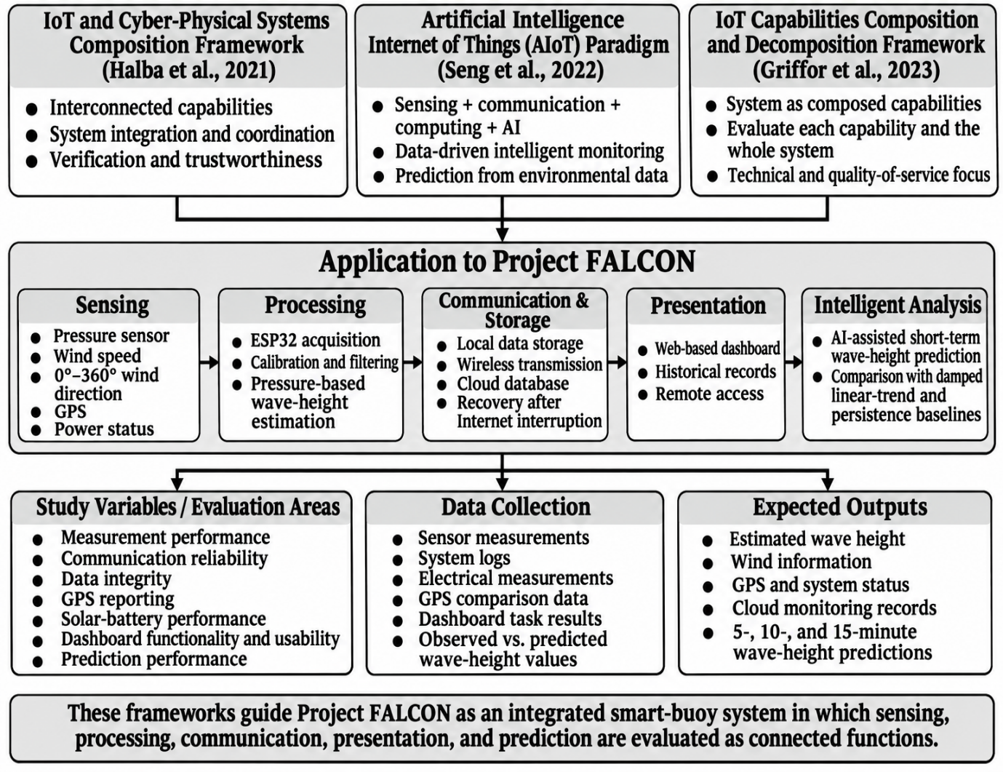
Theoretical Framework
APPLIED TO PROJECT FALCON
Sensing: pressure, wind speed and direction, GPS, and power status.
Processing: ESP32 calibration, filtering, and pressure-to-wave estimation.
Communication and cloud: Wi-Fi/LTE, storage, and dashboard.
Intelligent analysis: 15-minute prediction and baseline comparison.
Figure 1.4.1 Theoretical Framework of Project FALCON
16
Notes:
Point to the flow from frameworks to study variables, data collection, and expected outputs.

Slide 17
Conceptual Paradigm
INPUT–PROCESS–OUTPUT WITH VALIDATION
INPUT
PROCESS
OUTPUT
Water-pressure data
Wind speed and 0°–360° direction
GPS location
Solar and battery status
System and site requirements
Sensor data acquisition
Calibration and filtering
Pressure-to-wave-height estimation
Wireless upload and storage
Dashboard display and forecasting
Estimated wave height
Wind speed and direction
GPS and system status
Cloud monitoring records
Prediction and performance results
VALIDATION & FEEDBACK • reference comparison • power • transmission • usability • redesign
17
Notes:
Read the three columns and stress the feedback loop: test results feed design improvement.

Slide 18
Significance of the Study
WHO BENEFITS
DOST — a reference for integrating IoT, renewable energy, and AI in coastal monitoring.
Coastal residents and fisherfolk — additional wave and wind information for awareness and planning.
Barangays and local government offices — supplementary environmental data for local planning.
Philippine Coast Guard — supplementary coastal observation, not a replacement for official advisories.
Future researchers — a documented architecture, data process, and evaluation method for similar buoys.
18
Notes:
Keep the claims modest: the system supports awareness and research; it is not an official warning service.

Slide 19
Statement of the Problem
OBJECTIVES AND RESEARCH QUESTIONS
The study aims to design, develop, and evaluate a solar-powered smart buoy for wave, wind-speed, and 0°–360° wind-direction monitoring with transparent short-term wave-height forecasting.
1. How can FALCON be designed and developed as an integrated buoy combining pressure-based wave estimation, wind sensing, GPS, ESP32 acquisition, solar power, wireless transmission, and cloud monitoring?
2. How does it perform in wave-height estimation, wind speed and direction, transmission and storage, GPS tracking, and solar-battery operation under the selected test conditions?
3. How accurately can the forecasting component generate 15-minute-ahead wave-height predictions compared with persistence and damped linear-trend baselines?
4. How functional and usable is the cloud-based dashboard in presenting wave, wind, GPS, power, and prediction information?
19
Notes:
Read the main objective, then summarize the four questions. Note the scope: bench, controlled water, and limited near-shore validation.

Slide 20
Methodology
DEVELOPMENTAL RESEARCH DESIGN
Developmental research design supported by quantitative measurements and selected qualitative feedback.
Prototyping model — requirements, quick design, build, initial evaluation, refinement, and final implementation.
Three testing stages — bench testing, controlled water testing, and limited near-shore validation when approved.
Data for prediction — approximately one month of validated two-minute records.
Evaluation areas — accuracy, communication reliability, power, data integrity, dashboard usability, and prediction.
20
Notes:
Explain that the prototype is refined between stages, not tested once at the end.

Slide 21
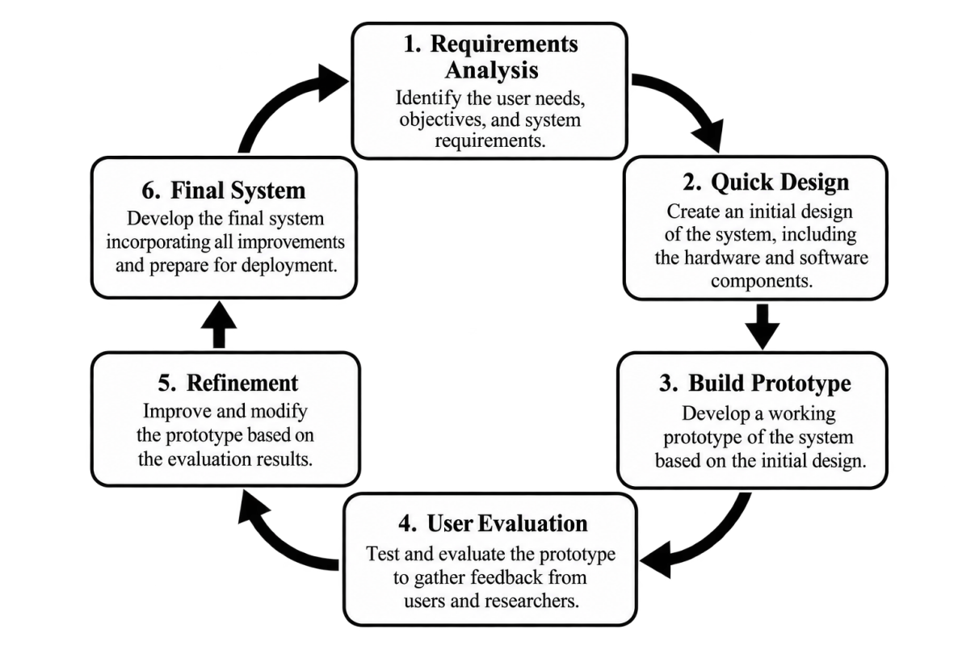
Research Design / Project Development Methodology
ITERATIVE PROTOTYPING
Requirements define sensors, power, communication, storage, and dashboard needs.
Quick design produces the block diagram, architecture, data flow, and layout.
Build and evaluate the first working prototype.
Refine based on test results, then document the final configuration.
Issues are corrected before the next testing stage.
Figure 2.1.1 System Development Life Cycle (Prototyping Model)
21
Notes:
The model is iterative: each loop produces a working output that is checked and improved.

Slide 22
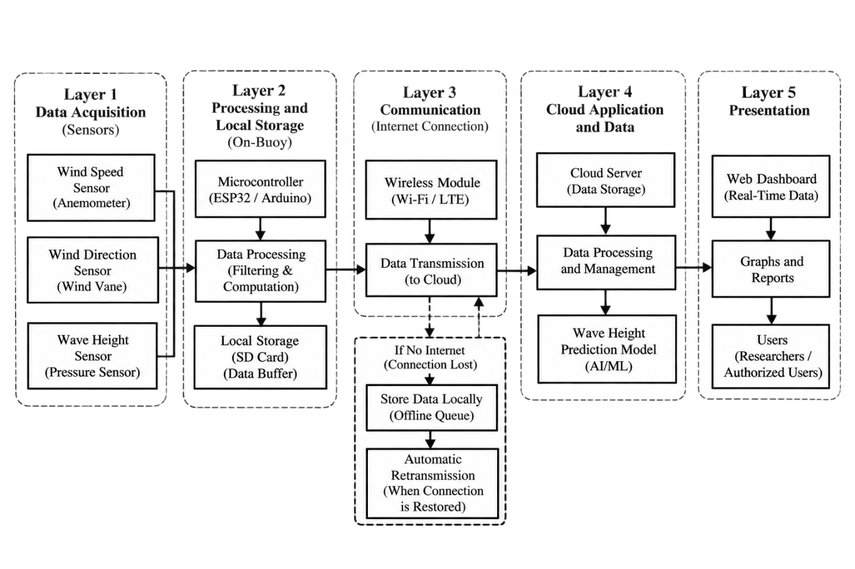
System Architecture / Framework
FIVE FUNCTIONAL LAYERS
Acquisition: pressure, wind, GPS, and power inputs.
Processing and storage: ESP32 sampling, timestamps, filtering, and local queue.
Communication: Wi-Fi or LTE upload of the two-minute summary.
Cloud: storage, prediction, and dashboard API.
Presentation: authorized dashboard and a separate public map view.
Figure 2.2.2 Project FALCON System Overview
22
Notes:
Walk through the five layers and emphasize what happens when connectivity is lost.

Slide 23
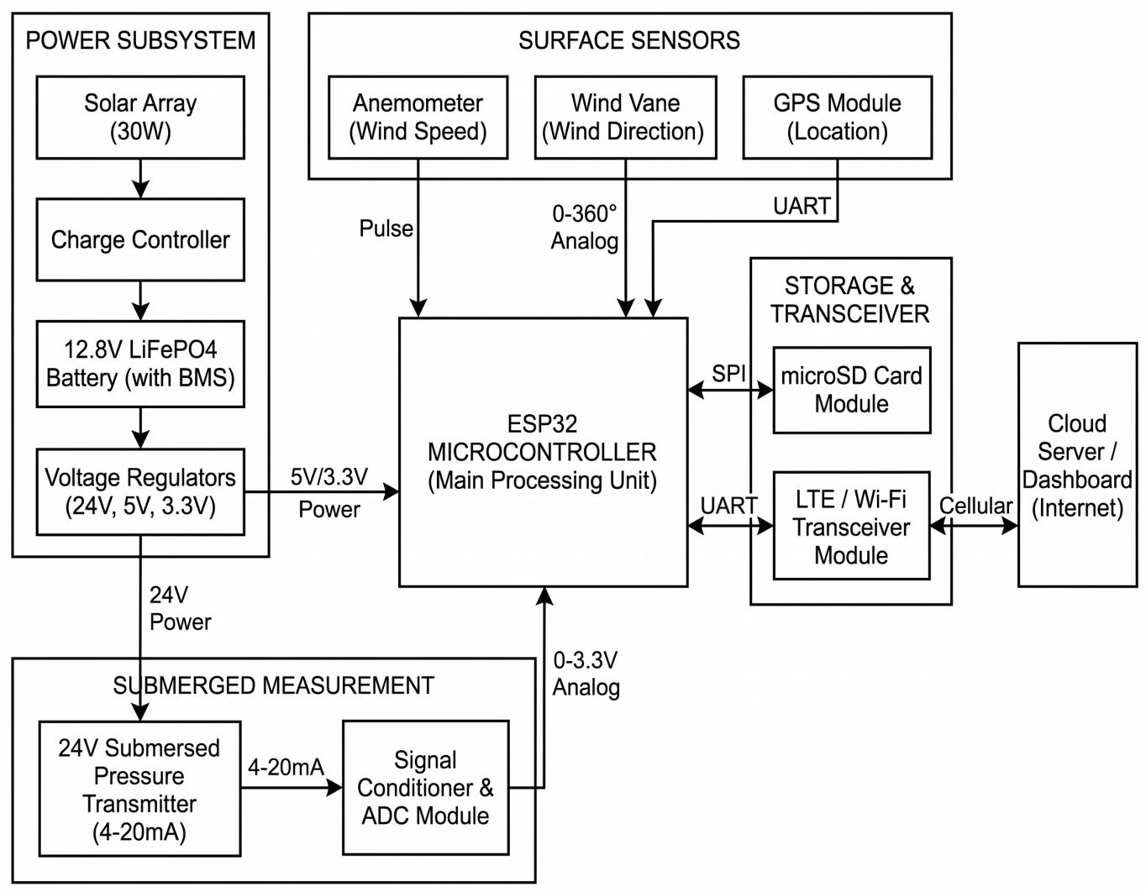
System Architecture
HARDWARE BLOCK DIAGRAM
ESP32 is the main controller; only the ESP32 is confirmed for procurement.
Pressure transmitter: 24 V, 4–20 mA, with a signal-conditioning and ADC interface.
Wind speed and direction, GPS, microSD storage, and Wi-Fi/LTE communication.
Power: solar array, LiFePO4 charge controller, 12.8 V 8 Ah battery, and regulated rails.
The pressure sensor is fixed to a seabed frame; a separate mooring line holds the buoy.
Figure 2.2.3 Project FALCON Hardware Block Diagram
23
Notes:
State clearly that all blocks except the ESP32 remain proposed or candidate parts pending validation. The 30 W solar label is the proposal's nominal figure; panel wattage and the 3S2P wiring still require verification.

Slide 24
Data Collection Methods
FIVE DATA GROUPS
Activity | Sensor or module | Output or action
Water pressure | Submerged 4–20 mA transmitter and ESP32 | Timestamped raw pressure samples retained for wave analysis
Wind observation | Cup anemometer and wind vane | Wind speed and 0°–360° direction summarized per window
Position and status | GPS/GNSS receiver and ESP32 | Position, time, geofence status, and device health
Power monitoring | LiFePO4 battery, charge controller, panels, power monitor | Voltage, current, charging status, and quality flags
Scheduled transmission | Wi-Fi or LTE module and cloud service | One summary packet every two minutes; queued records recovered after outage
Pressure is sampled locally at a proposed 4 Hz; each record carries a timestamp, unit, source, and quality status.
24
Notes:
Explain the two-minute summary packet and the retained raw pressure samples for recalculation.

Slide 25
Software and Tools Used
BUILD AND EVALUATION STACK
Firmware — C++ with the Arduino framework and PlatformIO for sampling, timestamps, buffering, and uploads.
Service — Python HTTP service for telemetry validation, alerts, and pressure-derived wave processing.
Storage — SQLite for telemetry, predictions, alerts, and system events across restarts.
Dashboard — React 19, TypeScript, and Vite, with Leaflet for maps and Lucide for interface icons.
Analysis — Python or spreadsheet tools for MAE, RMSE, MBE, PDR, completeness, and power metrics.
Testing — reference instruments, multimeter or power meter, network logs, and a usability form.
25
Notes:
Match the tools to the functions they support. Mention that the dashboard is already prototyped.

Slide 26
Development Procedures
FROM REQUIREMENTS TO FINAL PROTOTYPE
Requirements gathering — coastal-monitoring needs, budget, data fields, power, and deployment constraints.
Design — buoy configuration, block diagram, flowchart, firmware logic, power plan, and data structure.
Build and integrate — controller, sensors, storage, power, enclosure, mast, and mooring.
Calibrate and verify — known water depths, 4–20 mA loop, timestamps, buffering, and uploads.
Test, refine, and finalize — bench, controlled water, outage recovery, power, dashboard, and near-shore validation.
26
Notes:
Emphasize calibration and outage testing before any field-oriented work.

Slide 27
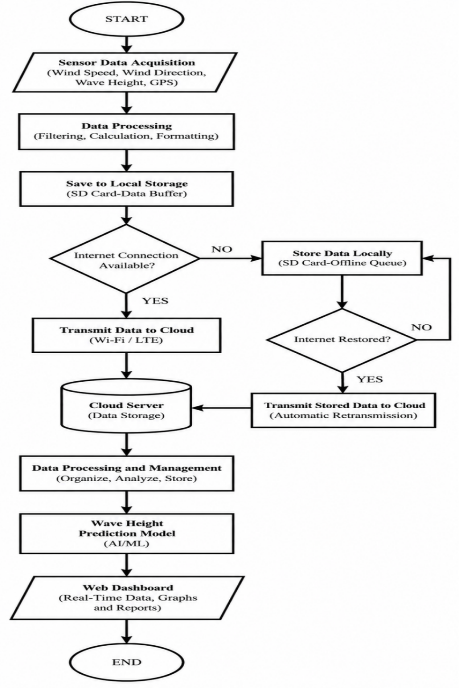
System Flowchart
CONTINUOUS OPERATION
Acquire pressure, wind, GPS, and power data; timestamp and process each record.
Store raw samples locally and prepare a two-minute summary packet.
If connectivity is available, upload the summary and any queued records.
If connectivity is lost, keep sensing and queue records with original timestamps.
After recovery, transmit queued records before resuming scheduled uploads.
The process is continuous; it does not stop after one dashboard update.
Figure 2.2.4 Project FALCON System Flowchart
27
Notes:
Point out that the flowchart is continuous; the queue prevents data loss during outages.

Slide 28
Testing and Evaluation
PROCEDURE
TEST SEQUENCE
VALIDATION AND ANALYSIS
Pre-test inspection and reference instruments
Bench calibration and functional testing
Measurement accuracy testing
Communication reliability and data integrity
Solar power performance
Limited near-shore validation when approved
AI-assisted prediction testing on held-out data
Dashboard usability testing
Comparison with independent references
Documentation of conditions and limitations
28
Notes:
Explain that testing moves from controlled conditions to limited field validation.

Slide 29
Testing and Evaluation
METRICS AND ACCEPTANCE TARGETS
Parameter | Metric or target | Method
Wave-height estimate | MAE, RMSE, MBE | Paired values against an independent reference
Wind speed | MAE | Paired readings against a reference anemometer
Wind direction | Mean angular error | Smallest 0°–360° angular difference
GPS location | Coordinate and distance error | Comparison with a trusted position
Transmission | PDR ≥ 98% during testing | Received ÷ sent packets × 100%
Data integrity | No loss of valid records or timestamps | Compare expected, stored, and received records
Power | Voltage, current, energy, runtime | Measured charge and discharge behavior
Prediction | MAE, RMSE, MBE | AI, persistence, and damped trend on the same test data
Dashboard | Functional check and usability feedback | Task-based evaluation form
29
Notes:
Highlight the only numeric target in the proposal: PDR of at least 98%. Other thresholds are to be established.

Slide 30
AI-Assisted Prediction Testing
EVALUATION DESIGN
Use approximately one month of validated two-minute records.
Align records on a consistent time grid; the target is the observation 15 minutes later.
Split chronologically into training, validation, and held-out testing portions.
Do not use future observations to train or tune the model.
Compare the model with persistence and a damped linear-trend baseline.
Report MAE, RMSE, and MBE; no accuracy claim is made without held-out results.
30
Notes:
The persistence baseline uses the latest observation; the damped trend uses recent changes with a reduced trend effect.

Slide 31
Ethical Considerations
RESPONSIBLE CONDUCT
Participation is voluntary and based on an informed-consent form in clear language.
Collect only necessary data; separate identifiers from responses and use codes.
Limit access to the research team and adviser; use controlled and encrypted storage where available.
Follow a written safety and retrieval plan; no deployment in severe weather or navigation channels.
Label dashboard data as experimental, stale, simulated, calibration-required, or unavailable.
Report unsuccessful tests and limitations; FALCON is not an official warning or navigation instrument.
31
Notes:
Mention the Data Privacy Act and the one-year retention period after the final defense.

Slide 32
References
SELECTED SOURCES (1 OF 2)
Alcantara, L. B., et al. (2023). Climate change awareness and risk perceptions in Palawan. UCL Open Environment, 5, e054.
Bethel, B. J., Sun, W., Dong, C., & Wang, D. (2022). Forecasting hurricane-forced significant wave heights using an LSTM network. Ocean Science, 18, 419–436.
Bullecer, B. A. S., Jabao, C. J. S., & Yahya, A. (2025). Remote water quality monitoring using solar-powered long-range communication. Mindanao Journal of Science and Technology, 23(2), 286–310.
Collins, C. O., III, et al. (2026). Measuring ocean surface waves. Reviews of Geophysics, 64(3), e2025RG000888.
Dabu, R. E. (2025). Storm tide and wave-induced hazards in Cagayan Coastal Boulevard. Critical Insights in Climate Change, 1(1), 2493964.
Dangan-Galon, F., et al. (2016). Mangrove diversity along Puerto Princesa Bay, Palawan. Journal of Marine and Island Cultures, 5(2), 118–125.
Department of Science and Technology–ASTI. (2024). 2024 annual report.
Dulohan, C. L., et al. (2022). Mangrove forest cover changes in Puerto Princesa Bay, 1999–2020. SPP-2022-PB-02.
Ebron, J. G. (2025). IoT multi-sensor and deep learning system for real-time water quality forecasting. Chemical Engineering Transactions, 122, 439–444.
Esteban, M., et al. (2023). Field survey of 2021 Typhoon Rai–Odette in the Philippines. Journal of Coastal and Riverine Flood Risk, 1, Article 1.
González-Reolid, I., et al. (2018). Autonomous solar-powered marine robotic observatory for shallow water. Sensors, 18(10), 3497.
Griffor, E., Halba, K., Lbath, A., & Dahbura, A. (2023). IoT capabilities composition and decomposition: A systematic review. IEEE Access, 11.
Halba, K., Griffor, E., Dahbura, A., & Lbath, A. (2021). A framework for the composition of IoT and CPS capabilities. IEEE COMPSAC, 1265–1272.
Complete APA reference list: Research Proposal, pp. 72–75.
32
Notes:
Selected references for the sources cited in this deck. The complete APA list is in the proposal, pp. 72–75.

Slide 33
References
SELECTED SOURCES (2 OF 2)
Hou, B., et al. (2024). Predicting significant wave height in the South China Sea using SAC-ConvLSTM. Frontiers in Marine Science, 11, 1424714.
Jabbar, W. A., et al. (2024). LoRaWAN-based IoT system for water quality monitoring in rural areas. Expert Systems with Applications, 242, 122862.
Kar, S., et al. (2024). XWaveNet: Short-term wave height forecasts and extreme event prediction. Applied Ocean Research, 148, 103994.
Lyman, T. P., et al. (2020). Open Wave Height Logger: An open-source pressure sensor data logger. Limnology and Oceanography: Methods, 18(7), 335–345.
Mabanag, M. J. F., et al. (2024). IoT-based water monitoring with geologic mapping. Journal of Multidisciplinary Studies, 13(2), 195–215.
Madarcos, K. G., Alcantara, L. B., & Creencia, L. A. (2026). Perceived climate change impacts in Puerto Princesa City. UCL Open Environment, 8, e3512.
McLeod, I., & Ringwood, J. V. (2022). Powering data buoys using wave energy: A review. Journal of Ocean Engineering and Marine Energy, 8, 417–432.
Pacaldo, J. C., Bilgera, P. H. T., & Abundo, M. L. S. (2022). Nearshore wave energy in Cuyo Island, Palawan. Energies, 15(22), 8637.
Seng, K. P., Ang, L. M., & Ngharamike, E. (2022). Artificial intelligence Internet of Things. International Journal of Distributed Sensor Networks, 18(3).
Sumeldan, J. D. C., et al. (2021). Perceived marine environment quality in Palawan. Frontiers in Psychology, 12, 661810.
Trevathan, J., & Schmidtke, S. (2022). Open-source IoT remote aquatic environmental sensing. HardwareX, 12, e00336.
Xiao, J., & Lu, P. (2024). Conformer–LSTM hybrid for ocean wave height prediction. Applied Sciences, 14(14), 6139.
Yang, B., et al. (2025). Maximum wave height prediction with LightGBM and TCN-BiGRU. Journal of Marine Science and Engineering, 13(10), 2009.
Republic Act No. 10121 (2010); No. 10173 (2012); No. 10692 (2015); No. 9729 (2009).
Complete APA reference list: Research Proposal, pp. 72–75.
33
Notes:
Legal bases: PAGASA Modernization Act, Disaster Risk Reduction and Management Act, Climate Change Act, and Data Privacy Act.

Slide 34
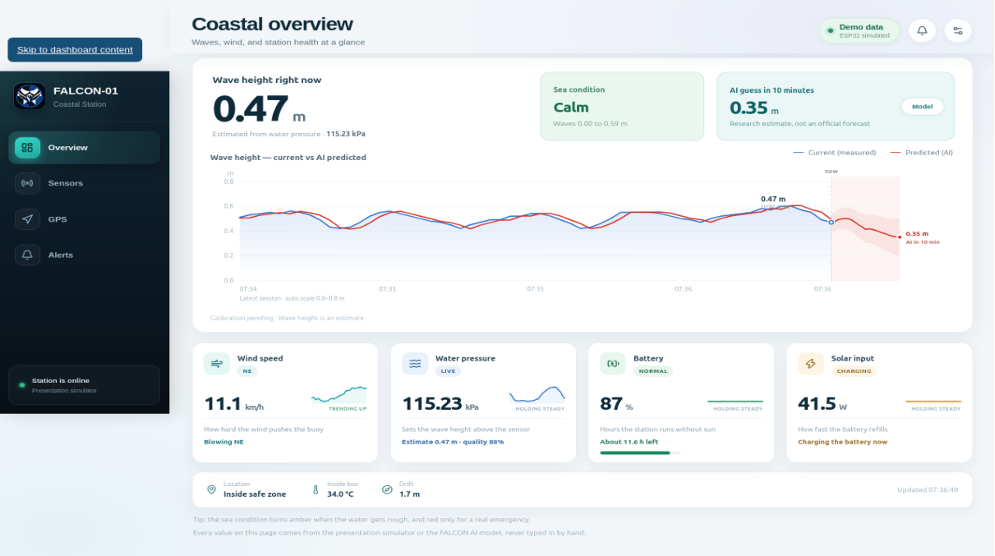
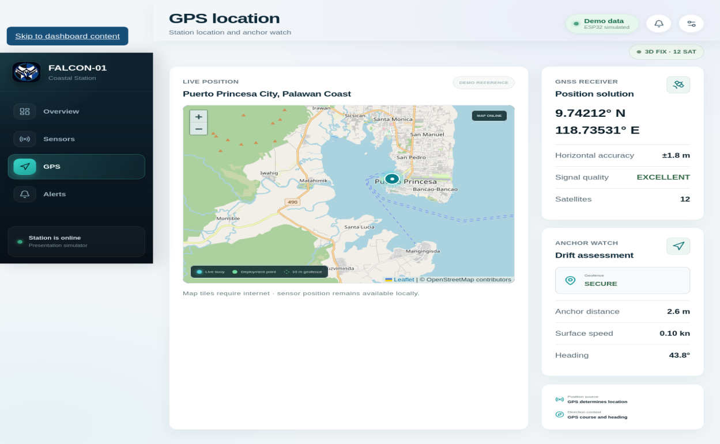
Appendices
AUTHORIZED MONITORING DASHBOARD
Figure 2.5.1 Dashboard Overview
Figure 2.5.3 GPS Location and Geofence
Overview: wave estimate, wind, power, and buoy status.
Sensors: wave and pressure, GPS and security, wind, power, and system cards.
GPS: position, fix quality, geofence, anchor distance, and drift.
Alerts and records: active alerts, history, and stored readings.
Values shown are prototype simulation data; field readings will carry source and validation labels.
34
Notes:
The screenshots are from the working dashboard prototype and are labeled as simulation data.

Slide 35
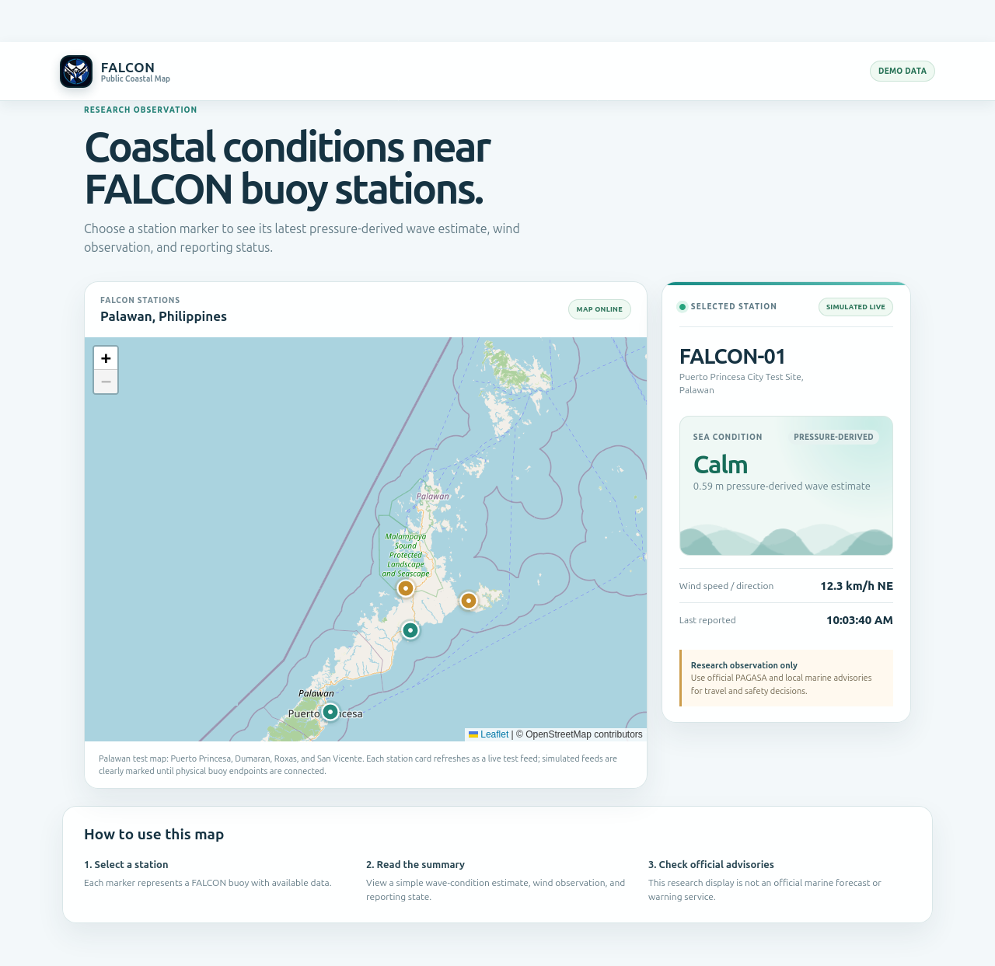
Appendices
PUBLIC USER DASHBOARD
A separate, read-only view for public monitoring.
Shows the Palawan map with buoy station markers.
Selecting a station shows wave condition, wind, reporting state, and last update.
Raw records, controls, security settings, and maintenance functions remain restricted.
The public view supplements awareness; it is not an official advisory service.
Figure 2.5.6 Public User Dashboard – Palawan Buoy Map and Selected Station
35
Notes:
Explain the separation between operator and public views.

Slide 36
Thank You
Questions and Suggestions
Project FALCON • Electronics and Computer Technology Department • Fullbright College
36
Notes:
Thank the panel and invite questions. Keep the proposal and test plan ready for follow-up details.

